Slide 1
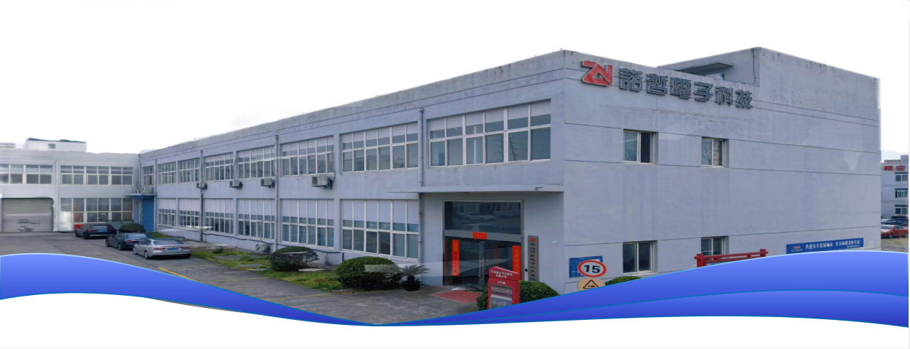

Slide 2
COMPANY PROFILE
Kunshan Nuozhe Electronic Technology Co., Ltd. was established on December 15, 2017. The company is located in the core area of advanced manufacturing industry in Kunshan City, Yushan Town Industrial Park, which is part of the Yangtze River Delta region.
It specializes in the technical research and development, processing, and sales of electronic products and spare parts molds, fixtures, stamping parts, and die-cut components.
Relying on the advantages of regional industrial chains, it focuses on providing high-precision hardware component solutions for the electronics, communication, automotive, and other fields. The company has always adhered to the team spirit and corporate philosophy of unity, dedication, responsibility, tolerance, innovation, and efficiency, striving to continuously meet customer needs with wholehearted efforts.

Slide 3
MAIN BUSINESS
Production and Development of Stamped Parts
Integrating mold design, stamping forming, and surface treatment, adopting fully automated production lines and CNC precision machining technology, offering one-stop services from material selection, process optimization to batch delivery, with rapid response and cost control advantages to help customers upgrade their products.
Development and Production of Die-Cutting Parts
R&D and manufacturing of die-cutting parts, equipped with fully automated die-cutting production lines and laser cutting technology, specializing in the processing of complex irregular shapes such as adhesive materials, foam, film, etc. Products include mobile phone sealing rings, display screen gaskets, insulation sheets for new energy batteries, etc.

Slide 4
PRODUCT SHOWCASE
Dust-Free Die-Cutting Workshop

Slide 5
PRODUCT SHOWCASE
Stamping Workshop

Slide 6
PRODUCT SHOWCASE
Stamping operation

Slide 7
PRODUCT SHOWCASE
MQ-320/420H Die Cutting Machine

Slide 8
PRODUCT SHOWCASE
Connectors, laptops, headphones, wireless chargers
and other precision components

Slide 9
PRODUCT SHOWCASE
Automated Forming Machine Salt Spray Test

Slide 10
CONTACT US
Add.:No.6 Factory building,199 Fucheng Road,Yushan Town, Kunshan City,Jiangsu Province,P.R.China
Tel.:86-13862608851
Email:nz@ks-nuozhe.com
Webpage:https://ks-nuozhe.com

